Slide 1
Reduced-Complexity Models of Air Quality for Africa: Overview
NACA RCM Workshop
Kempton Park, South Africa
October 4, 2022

Slide 2





Our Workshop Team
Peter Adams (CMU)
Rebecca Garland (U Pretoria)
Medinat Akindele (CMU)
Anzel de Lange (U Limpopo)
Mogesh Naidoo (CSIR)

Slide 3
My background
25+ years experience with most complex air quality models (CTMs)
21 years in CMU’s Department of Engineering and Public Policy
Served on many technical advisory committees to US EPA (and state and county levels)
These experiences have persuaded me that RCMs are a promising tool for better policy-making.

Slide 4
Agenda for Today
Everything will be posted online!
9:00 AM: Morning session #1
Introduction to Reduced-Complexity Models (RCMs)
Frameworks for RCM Analysis
Problems #1 and #2
10:20 AM: Morning break
10:40 AM: Morning session #2
Overview of PM2.5 and Impact Assessment
Willingness to pay and Value of Statistical Life (VSL)
Policy and Decision-making Frameworks
12:00: Lunch
1:00 Afternoon session #1
Problems #3 and #4
Problem #5: Realistic RCM application
RCMs and Their Evaluation
2:50 Afternoon break
3:10 Afternoon session #2
Best Practices
Foundational concepts and conceptual questions
Realistic application
Wise use of RCMs

Slide 5
Topic 1: Introduction to Reduced-Complexity Models (RCMs)
NACA RCM Workshop
Kempton Park, South Africa
October 4, 2022

Slide 6
Air Quality Management: A System
Decision-maker
Air quality model
Ambient monitoring
Emissions, monitoring, and modeling all important
The ultimate goal of the whole system is to make better decisions
Air pollution models play a central role
Emissions data

Slide 7
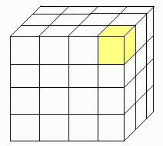

Chemical Transport Models (CTMs)
Divide atmosphere into 3D grid of locations
Each grid box has a mass balance (“continuity” equation)
Use rate of change (dc_{i}/dt) to step forward in time
Grid Set-up:
Advection
Reaction
A + B → C
Vertical Height (z)
North – South (y)
East – West (x)
Emission, E_{i}
Deposition, D_{i}
Notes:
I made some minor modifications to help understand better

Slide 8
Chemical Transport Models
Inputs: emissions (and meteorology)
Outputs: pollutant concentrations (x,y,z,t)
Common CTMs:
WRF-Chem, CAMx, CMAQ
… are resource intensive
Hard disk space, CPU time
…require extensive training, lots of time to prepare inputs and analyze outputs

Slide 9
Air Quality Management: A System
Decision-maker
Air quality model
Ambient monitoring
In the US context…
Air quality model = CTM (chemical transport model)
Ambient monitoring…
~4000 sites
Expensive
We want low-cost models as well as low-cost sensors!
Emissions data

Slide 10
Questions that RCMs can help answer
What emissions reductions should I prioritize for my air quality plan?
Policy evaluation
How many lives saved? How much is concentration reduced?
Cost-effectiveness? Benefit-cost analysis?
Across species?
E.g. direct emissions of PM2.5 versus precursor gases (SO2, NOx, NH3, VOCs, etc.)
Across locations?
How much more damage is caused by emitting pollutants in densely populated regions?
To reduce concentrations at a location, how far away (upwind) do I need to think about emissions?

Slide 11
Impact Assessment
Air quality models are a way to ask “what if?” questions
Compare a present “baseline” to lower emissions under a control policy
Quantify changes in concentrations and health

Slide 12
Before We Start…
Many kinds of air pollution
Many kinds of damage
premature mortality (death), sickness, lost productivity, crop damages, visibility degradation, ecosystem damages, etc.
In this presentation, we are going to focus exclusively on premature mortality caused by PM_{2.5} (and its precursors)
Justified because this is >90% of monetized damages in cost-benefit analysis
The same techniques can be applied to other air pollutants and damages

Slide 13
Impact Assessment
Maps of concentrations c(x,y)
Health outcomes
Economic and policy analysis

Slide 14
RCM analysis is different than CTM analysis
…not just a way to save computer time for CTM people
Goal: greatly expand the number of people who can incorporate air quality into decisions
From AQ modelers to AQ managers, transportation planners, etc.
From national scale -> local scale

Slide 15
RCM analysis is different than CTM analysis
The mindset is also different…
Traditional CTM modeling | RCM analysis
Has to make a concentration map, c(x,y), as a first step | More focused on evaluating a decision (policy intervention) can go directly to health benefits without the map if desired
Needs comprehensive emissions inventories to get “baseline” simulation | Thinking marginally: doesn’t depend on comprehensive emissions scenarios Can directly evaluate changes in health, concentration based on emissions changes in sector of interest

Slide 16
Policy Analysis Process
Develop candidate policies
What can we do?
What is implementation cost?
What are emissions reductions?
Evaluate air quality benefits
How much will concentrations be reduced?
How many lives saved?
Evaluate policies and decide
Which policies are best?
Which policies are worth doing?
We will discuss briefly
Focus of this workshop

Slide 17
Topic 2: Frameworks for RCM Analysis
NACA RCM Workshop
Kempton Park, South Africa
October 4, 2022

Slide 18
RCMs: Really three different things…
RCM developers
RCM users
Reduced-complexity model
(several different methods)
Marginal damages
(mortalities or $ per tonne emitted)
Source-receptor matrix
(how emissions at location X impact concentrations at location Y)

Slide 19
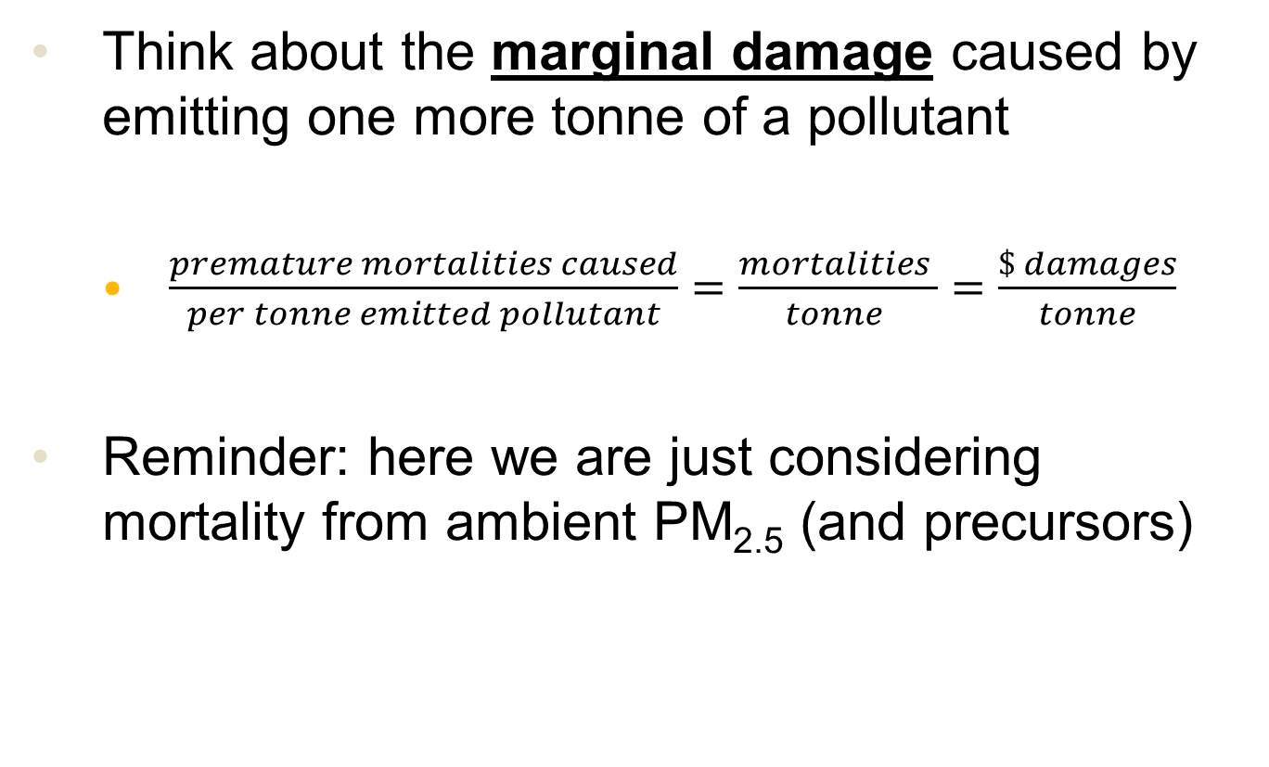
Air Pollution Impact Metrics
Think about the marginal damage caused by emitting one more tonne of a pollutant
$\frac{premature mortalities caused}{per tonne emitted pollutant}=\frac{mortalities }{tonne }=\frac{\$ damages}{tonne}$
Reminder: here we are just considering mortality from ambient PM_{2.5} (and precursors)

Slide 20
Air Pollution Impact Metrics
Marginal damages depend on
What species you emit
E.g. emitting 1 tonne of PM_{2.5} is worse than emitting 1 tonne of NOx because only some of the NOx will be converted into PM_{2.5}
Where you emit it
Emitting in a densely populated region will cause more health damages than emitting the same pollution away from people

Slide 21
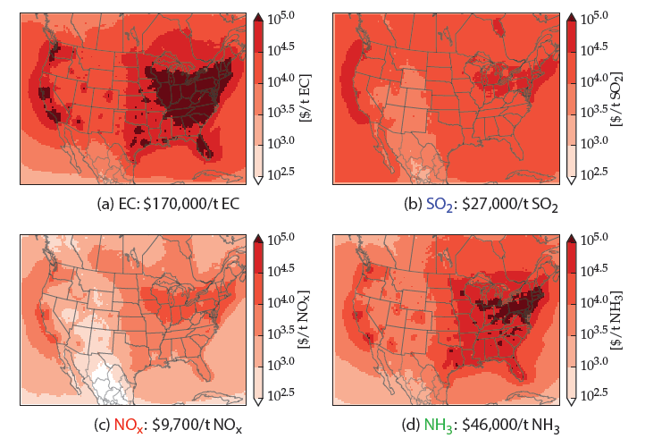
Sample Marginal Damages (EASIUR)
PM2.5
SO₂
NOTE: mortalities/tonne converted to $/tonne per standard US EPA methods
These are damages by source location
…for user, this is a “lookup table”
Spatial: Proximity to population centers
Species: PM_{2.5} formation efficiency
NO_{x}
NH₃

Slide 22
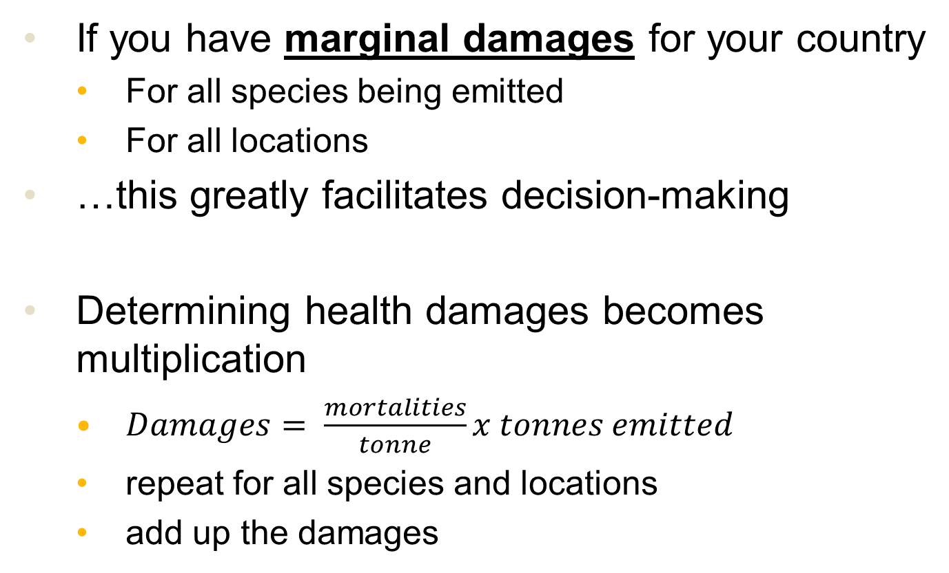
Air Pollution Impact Metrics
If you have marginal damages for your country
For all species being emitted
For all locations
…this greatly facilitates decision-making
Determining health damages becomes multiplication
$Damages= \frac{mortalities}{tonne}x tonnes emitted$
repeat for all species and locations
add up the damages

Slide 23
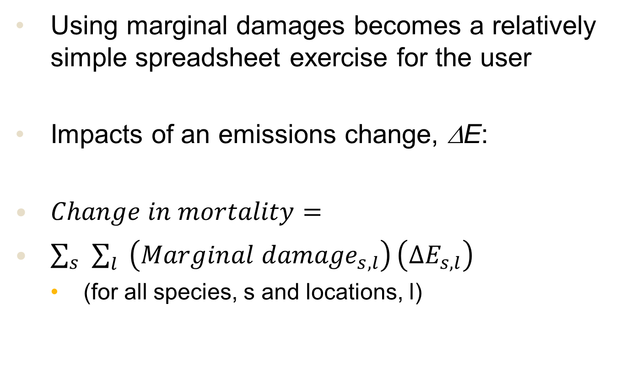
RCMs Use #1: Marginal Damages
Using marginal damages becomes a relatively simple spreadsheet exercise for the user
Impacts of an emissions change, ΔE:
$Change in mortality=$
$\sum_{s}{\sum_{l}{\left({Marginal damage}_{s,l}\right)}\left({∆E}_{s,l}\right)}$
(for all species, s and locations, l)

Slide 24
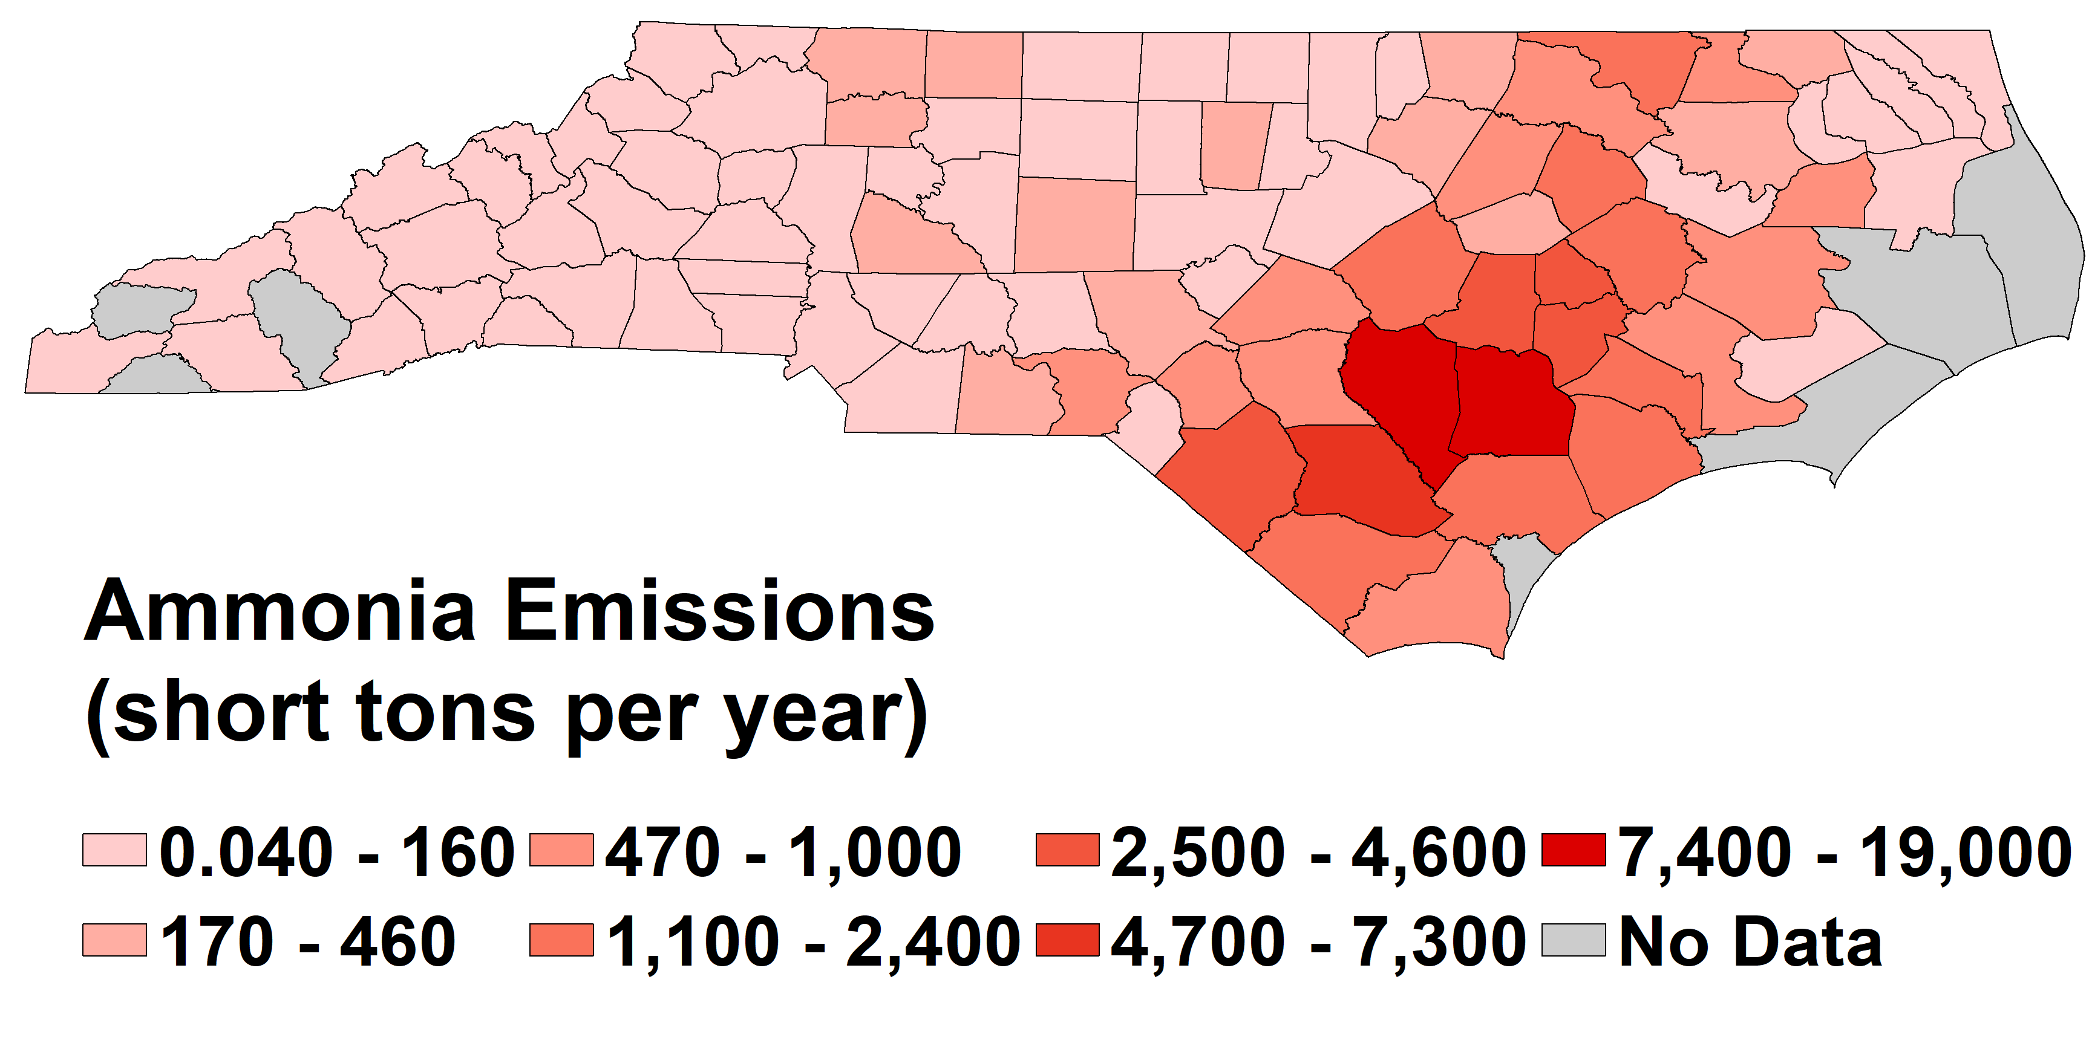
Sample Calculation
What are damages associated with swine production in NC?
(tons/yr)
NEI2011 projected to 2017 / SCC 2805039000

Slide 25
Spreadsheet Analysis
 |  |  | Total mortalities per year | 1331
County Name | County fips code | NH3 damages (mortalities/tonne) | Livestock NH3 emissions (tons/year) | Mortalities (per year)
Alamance | 37001 | 0.0118 | 0 | 0
Alexander | 37003 | 0.0107 | 1263 | 14
Alleghany | 37005 | 0.0088 | 0 | 0
Anson | 37007 | 0.0091 | 2959 | 27
Ashe | 37009 | 0.0091 | 0 | 0
Avery | 37011 | 0.0100 | 0 | 0
Beaufort | 37013 | 0.0062 | 807 | 5
Bertie | 37015 | 0.0075 | 1698 | 13
Total mortalities from emissions in all counties (sum of column)
Mortalities caused by emissions in that county
= (marginal social damage)
x (emissions)
…other counties (100 total)
Marginal social damage (mortalities/tonne) from RCM
Emissions inventory

Slide 26
RCMs Use #2: Source-Receptor
If you want spatially resolved output, things are only slightly harder
Divide your country/region into locations:
Regular Cartesian grid or municipalities
Locations = (l₁, l₂, l₃, … l_{N})
E.g. locations may be a list of countries*
Locations = (Angola, Botswana, Eswatini, Lesotho, Malawi, Mozambique, Namibia, South Africa, Zambia, Zimbabwe)
*short example: generally, RCMs are much higher resolution

Slide 27
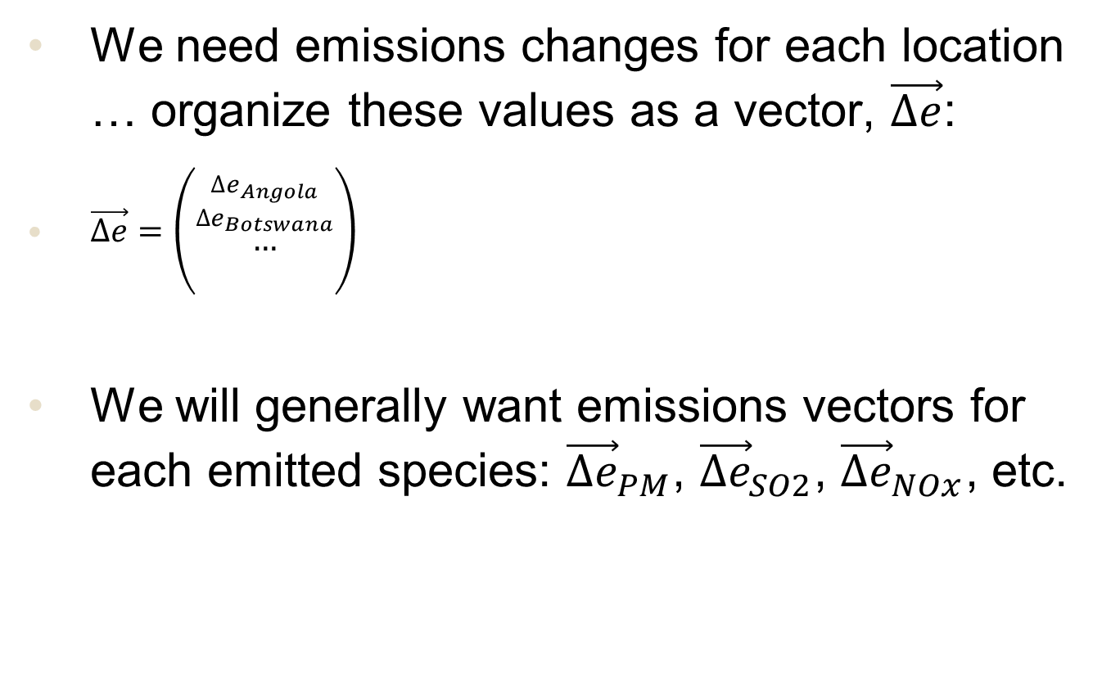
RCMs Use #2: Source-Receptor
We need emissions changes for each location … organize these values as a vector, $\vec{∆e}$:
$\vec{∆e}=\left(\begin{aligned}\begin{aligned}{{∆e}_{Angola} \atop {∆e}_{Botswana}} \\ …\end{aligned} \\ \end{aligned}\right)$
We will generally want emissions vectors for each emitted species: ${\vec{∆e}}_{PM}$, ${\vec{∆e}}_{SO2}$, ${\vec{∆e}}_{NOx}$, etc.

Slide 28
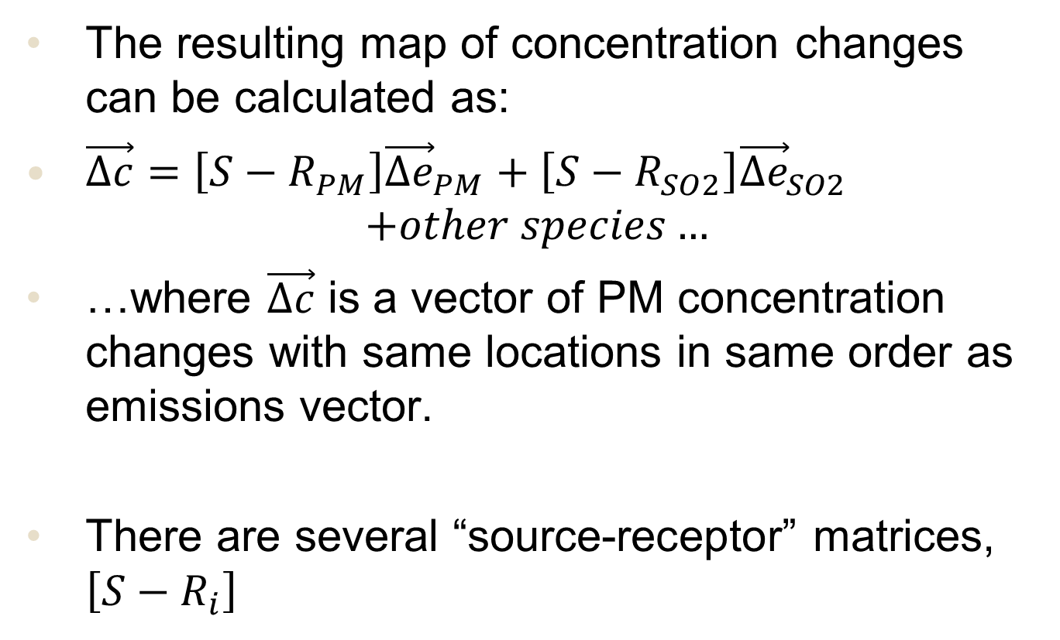
RCMs Use #2: Mapping Changes
The resulting map of concentration changes can be calculated as:
$\vec{∆c}=\left[{S−R}_{PM}\right]{\vec{∆e}}_{PM}+\left[{S−R}_{SO2}\right]{\vec{∆e}}_{SO2}$
$$+other species…$$
…where $\vec{∆c}$ is a vector of PM concentration changes with same locations in same order as emissions vector.
There are several “source-receptor” matrices, $\left[{S−R}_{i}\right]$

Slide 29
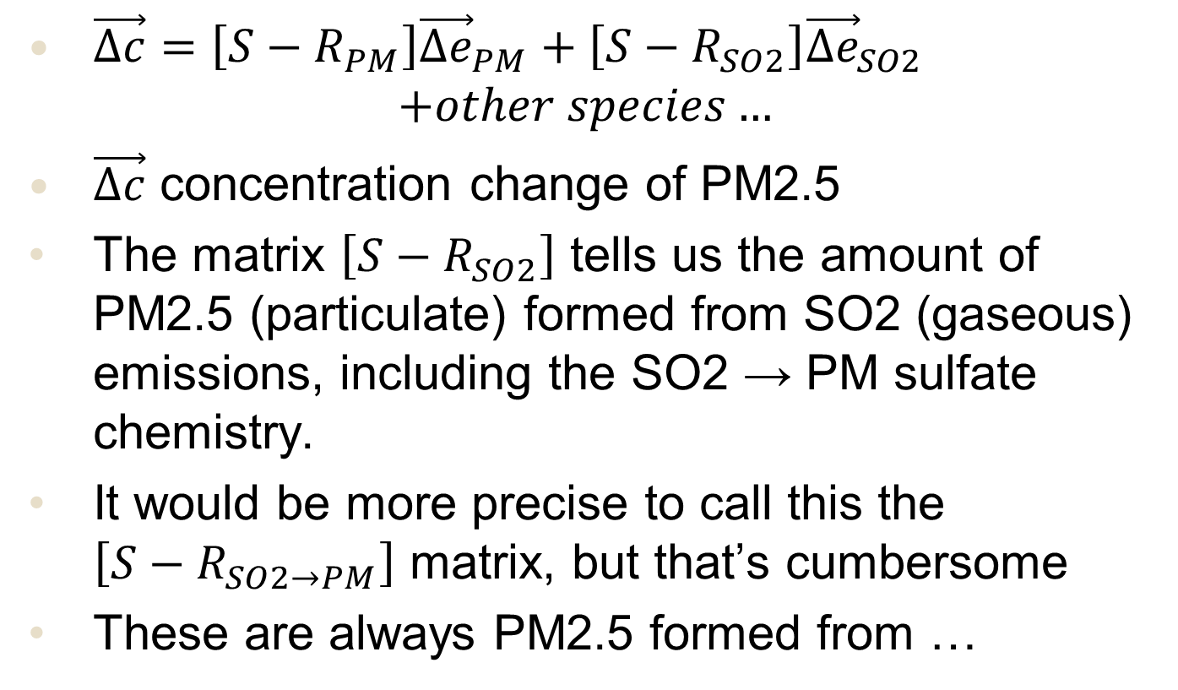
Important Note About Notation
$\vec{∆c}=\left[{S−R}_{PM}\right]{\vec{∆e}}_{PM}+\left[{S−R}_{SO2}\right]{\vec{∆e}}_{SO2}$
$$+other species…$$
$\vec{∆c}$ concentration change of PM2.5
The matrix $\left[{S−R}_{SO2}\right]$ tells us the amount of PM2.5 (particulate) formed from SO2 (gaseous) emissions, including the SO2 → PM sulfate chemistry.
It would be more precise to call this the $\left[{S−R}_{SO2→PM}\right]$ matrix, but that’s cumbersome
These are always PM2.5 formed from …

Slide 30
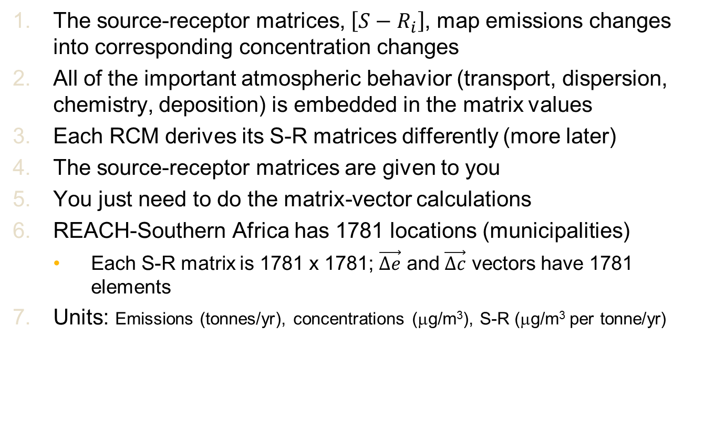
Source-Receptor Matrices
The source-receptor matrices, $\left[{S−R}_{i}\right]$, map emissions changes into corresponding concentration changes
All of the important atmospheric behavior (transport, dispersion, chemistry, deposition) is embedded in the matrix values
Each RCM derives its S-R matrices differently (more later)
The source-receptor matrices are given to you
You just need to do the matrix-vector calculations
REACH-Southern Africa has 1781 locations (municipalities)
Each S-R matrix is 1781 x 1781; $\vec{∆e}$ and $\vec{∆c}$ vectors have 1781 elements
Units: Emissions (tonnes/yr), concentrations (μg/m³), S-R (μg/m³ per tonne/yr)

Slide 31
RCMs: Really three different things…
RCM developers
RCM users
“Very easy”: ~1 hour with spreadsheet
Reduced-complexity model
(several different methods)
Marginal damages
(mortalities or $ per tonne emitted)
Source-receptor matrix
(how emissions at location X impact concentrations at location Y)
“Moderately easy”: few hours in programming environment (R, Python, etc.)

Slide 32
Available RCMs
APEEP
Air Pollution Emission Experiments and Policy
Nick Muller (CMU, formerly Middlebury)
Gaussian dispersion + simple chemistry
EASIUR
Estimating Air pollution Social Impacts Using Regression
Peter Adams and Jinhyok Heo (CMU)
statistical model fitting tagged CTM simulations
InMAP
Intervention Model for Air Pollution
Chris Tessum and Julian Marshall (UW, formerly Minn)
annual-average CTM with process rates from WRF-Chem
GAINS
Greenhouse gas-Air pollution InteractioNs and Synergies model
IIASA
Source-receptor matrix derived from TM5 simulations

Slide 33
Marginal Changes / Linear Models
The marginal social cost and source-receptor approaches are both linear models
Impacts (concentration and mortality changes) are proportional to emissions changes
RCMs assume linear responses
A good assumption for small changes in emissions OR for PM species that behave linearly
We will discuss limitations of this assumption in more detail later
For now, note that it tends to work much better than most air quality people think it will

Slide 34
Marginal vs Average Changes
“Marginal change”: RCM provides linear model around baseline
Concentration or mortality
Nonlinear response
“baseline” (current situation)
Average response (model)
Emissions (e.g. NOx)

Slide 35
Working Mini-Session
Please work on
Problem #1
Problem #2
https://drive.google.com/drive/folders/1SJhJHQRyf2aCbIu7xLTJTIYq2kjEkizu

Slide 36
Solution Overview: Problem #1
Species | Emissions (tonnes/yr)¹ | Marginal health impact (mortalities/tonne)² | Mortalities/yr
Primary PM2.5 | 9.60E+05 | 7.20E-03 | 6912
SO2 | 3.30E+06 | 4.80E-03 | 15840
NOx | 2.40E+06 | 3.10E-04 | 744
NH3 | 8.50E+05 | 2.10E-03 | 1785
Anthropogenic VOCs | 3.10E+06 | 4.50E-04 | 1395
 |  | Total | 26676
Mortalities caused
= (marginal social damage)
x (emissions)
= Total across species

Slide 37
Discussion: Problem #1
Note that marginal impacts depend strongly on source location.
Total estimated mortalities are ~26,000 per year due to ambient exposure
Independent source puts it at ~10,000
(The cost of air pollution in Africa, OECD Working Paper No. 333, Sep 2016.)
Primary PM2.5, SO2, and NH3 have highest damages per tonne
SO2 causes most mortalities (highest emissions; 2nd highest marginal damages)

Slide 38
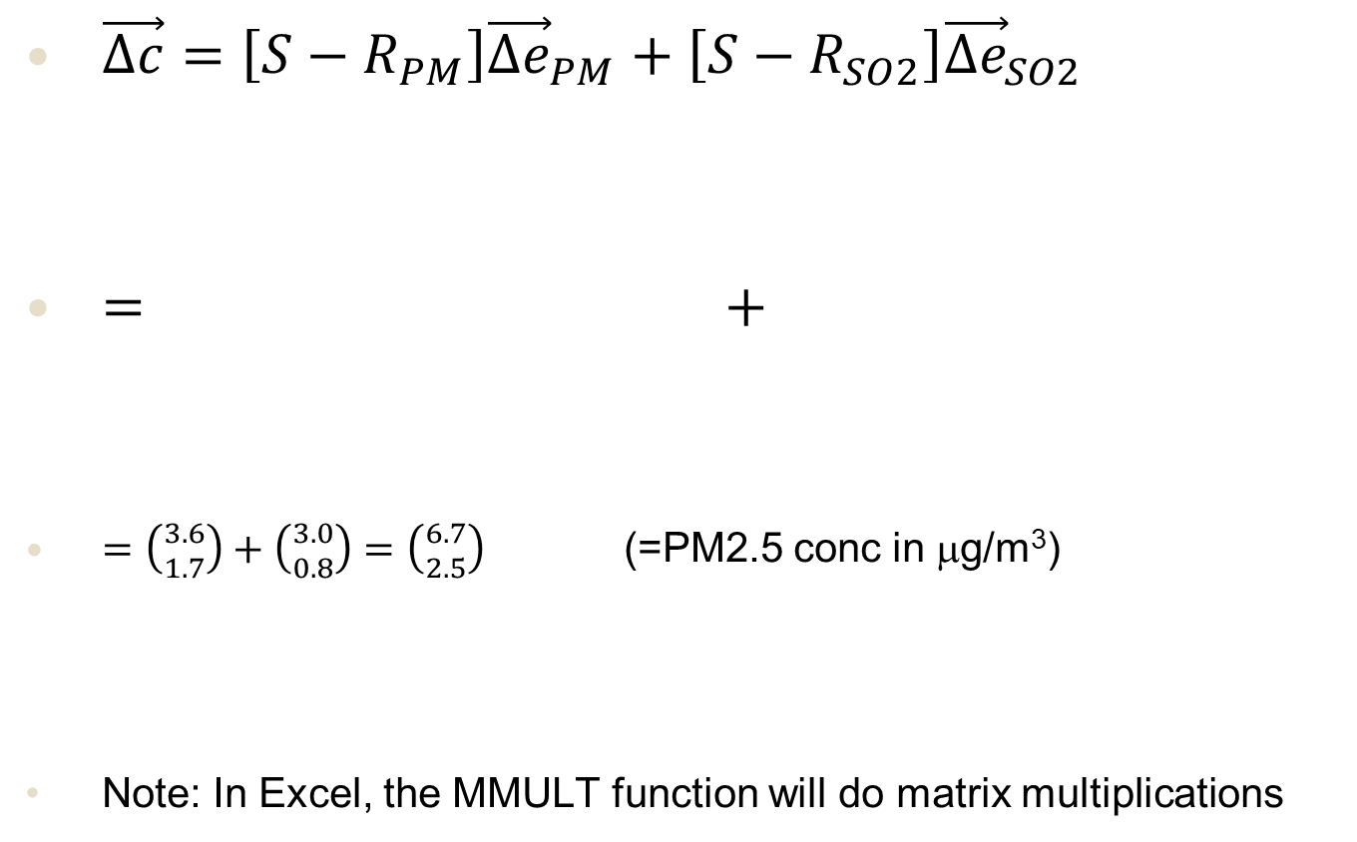
Solution Overview: Problem #2
$\vec{∆c}=\left[{S−R}_{PM}\right]{\vec{∆e}}_{PM}+\left[{S−R}_{SO2}\right]{\vec{∆e}}_{SO2}$
$=$ $+$
$=\left({3.6 \atop 1.7}\right)+\left({3.0 \atop 0.8}\right)=\left({6.7 \atop 2.5}\right)$ (=PM2.5 conc in μg/m³)
Note: In Excel, the MMULT function will do matrix multiplications
 | E | W
E | 4.00E-06 | 1.00E-06 |  | 7.80E+05
W | 2.00E-07 | 3.00E-06 |  | 5.20E+05
 | E | W
E | 1.80E-06 | 7.00E-07 |  | 1.62E+06
W | 3.00E-07 | 1.50E-06 |  | 1.80E+05

Slide 39
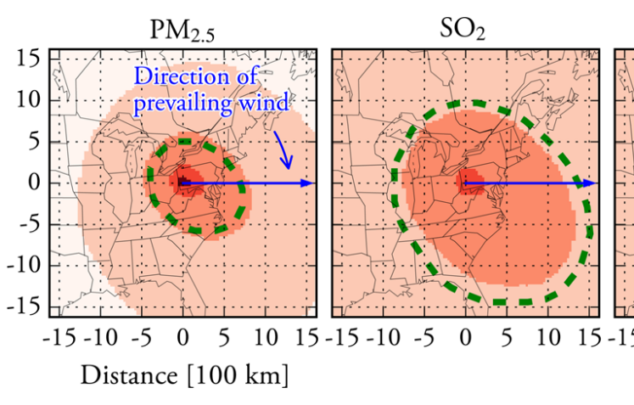
Discussion: Problem #2
Two-region example just to illustrate how source-receptor matrices work
Actual RCMs have 1000s or 10,000s of locations
Figure shows S-R matrices for EASIUR-USA.
Dashed lines encompass 80% of concentration from unit emission.
Primary PM2.5 has plume of ~1000 km; SO2 is ~2000 km.
Impacts from gaseous precursors are more spread out.
Heo et al. ES&T, 2016.

Slide 40
Topic 3: Overview of PM2.5 and Impact Assessment
NACA RCM Workshop
Kempton Park, South Africa
October 4, 2022

Slide 41
Fine Particulate Matter (PM)
There are many kinds of air pollution
Here we focus on PM2.5
= particulate matter with diameter less than 2.5 microns
Often called “fine” PM (versus “coarse” PM = the larger particles)
These particles are small enough to penetrate deeply into the lungs
Mostly, we are concerned with the mass concentration of PM2.5 (μg/m³)
Some countries regulate PM1 (diameter < 1 micron)
But PM2.5 ≈ PM1 since most PM2.5 is actually < 1 micron anyway
With very minor adjustment, these RCMs can be used for PM1 equally well

Slide 42
Fine PM Composition
Sulfate
Major inorganic components;
Also, they interact chemically with each other
Nitrate
Ammonium
These species usually are most (> 80%) of the PM2.5 mass
Organic carbon
Elemental carbon
“carbonaceous” PM
Other: trace metals, crustal, etc.

Slide 43
Primary vs Secondary PM
Secondary
A gaseous precursor (e.g. SO2) is emitted
Atmospheric chemistry oxidizes the precursor
Some or all of the product ends up in particulate phase
Sulfate
Nitrate
Secondary organic carbon, secondary organic aerosol (SOA)
Ammonium
Organic carbon
Primary
Directly emitted to atmosphere as a particle
Primary organic carbon, primary organic aerosol (POA)
Elemental carbon
Other: trace metals, crustal, etc.

Slide 44
Major Sources
Coal combustion
SO2(g)
Sulfate
Combustion
NO + NO2(g)
Nitrate
Agriculture
NH3(g)
Ammonium
Various
VOCs(g)
Organic carbon
Combustion
Elemental carbon
Other: trace metals, crustal, etc.
Various

Slide 45
Modeling Implications
Many pieces are mostly separate from each other
Can do marginal impacts from one sector without comprehensive emissions inventory
Organic chemistry is complex, poorly understood
VOC → Secondary organic PM will have larger uncertainties
Sulfate-nitrate-ammonium system is nonlinear
Some large emissions changes will stretch RCM’s assumption of linear responses

Slide 46
Impact Assessment
Maps of concentrations c(x,y)
Health outcomes
Economic and policy analysis

Slide 47
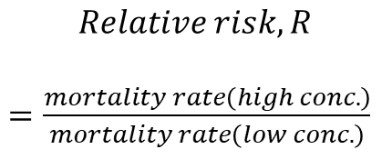
Relative Risk
Consider different populations exposed to different PM2.5 concentrations:
$$Relative risk, R$$
$=\frac{mortality rate\left(high conc.\right)}{mortality rate\left(low conc.\right)}$
Mortalities per 100,000 people
R = 1: no effect
R > 1: higher conc is riskier than lower conc
Convention is to report high – low conc = 10 μg/m3 increment
PM2.5 conentration

Slide 48
Concentration-Response Function
Premature mortality from chronic (annual-average) PM2.5 exposure
American Cancer Society (ACS) cohort
R = 1.06; 6% increase in mortality per 10 μg m⁻³
Harvard 6-Cities
R = 1.14; 14% increase in mortality per 10 μg m⁻³
Additional mortality from PM2.5
Baseline mortality (w/o PM)
PM2.5 concentration change
Relative risk

Slide 49
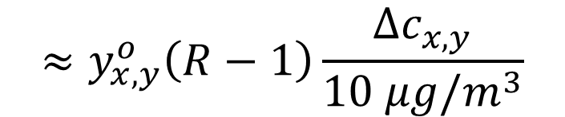
Concentration-Response Function
Note that the C-R is pretty linear:
(For R a little above 1 and atmospherically relevant Δc)
Use full equation for real calculations
… but proportional to Δc and (R-1) for “in your head”
$$≈y_{x,y}^{o}\left(R−1\right)\frac{{∆c}_{x,y}}{10 μg/m^{3}}$$

Slide 50
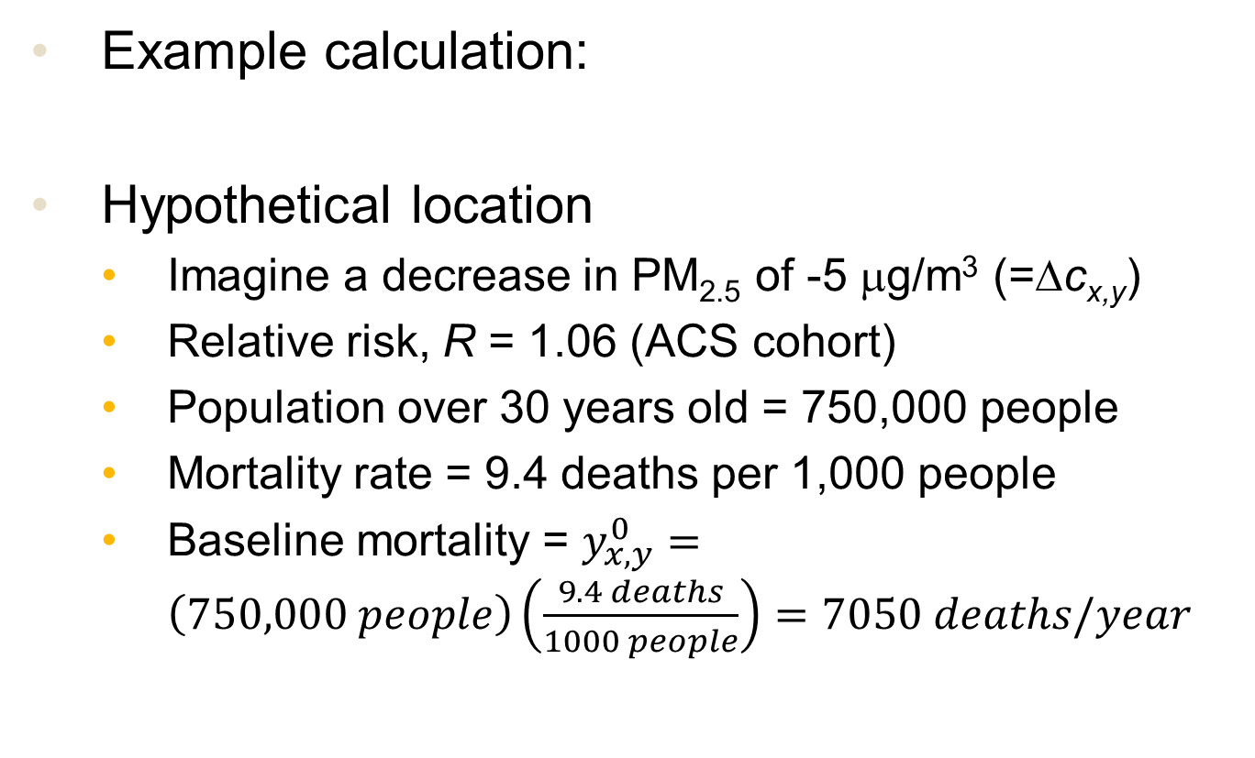
Concentration-Response Function
Example calculation:
Hypothetical location
Imagine a decrease in PM_{2.5} of -5 μg/m³ (=Δc_{x,y})
Relative risk, R = 1.06 (ACS cohort)
Population over 30 years old = 750,000 people
Mortality rate = 9.4 deaths per 1,000 people
Baseline mortality = $y_{x,y}^{0}=\left(750,000 people\right)\left(\frac{9.4 deaths}{1000 people}\right)=7050 deaths/year$

Slide 51
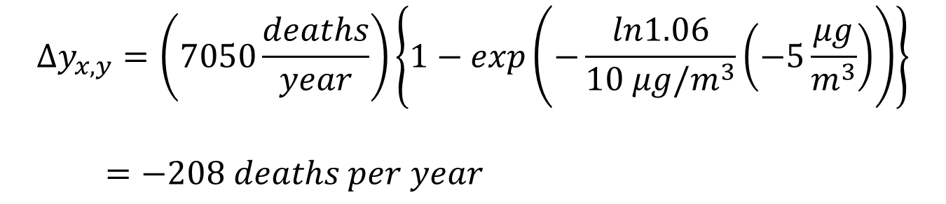
Concentration-Response Function
Example calculation:
$$∆y_{x,y}=\left(7050\frac{deaths}{year}\right)\left\{1−exp\left(−\frac{ln1.06}{10 μg/m^{3}}\left(−5\frac{μg}{m^{3}}\right)\right)\right\}$$
$=−208 deaths per year$

Slide 52
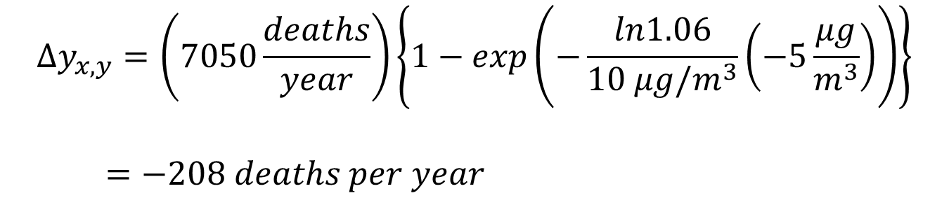
Concentration-Response Function
Example calculation:
Notes:
Negative: decreased PM conc. → fewer deaths
R = 1.06 means a 6% increase in all cause mortality for a 10 μg/m3 increase in PM_{2.5}
Here we get a ~3% decrease for a -5 μg/m³ change
Functional form is complex; but response is ~linear
$$∆y_{x,y}=\left(7050\frac{deaths}{year}\right)\left\{1−exp\left(−\frac{ln1.06}{10 μg/m^{3}}\left(−5\frac{μg}{m^{3}}\right)\right)\right\}$$
$=−208 deaths per year$

Slide 53
Proper Use of Relative Risk
Relative risk, R, derived from an epi study of a particular cohort of people
Need to apply equation consistent with how R is derived
Age: many cohorts are people >30 years old
Must apply only to population >30 years old, using mortality rate for people >30 years old
Cause: e.g. respiratory, cardiovascular or “all cause”
“all cause” is most useful/common → use baseline mortality rate from all causes
… or could get increase in respiratory deaths by using a R value for respiratory deaths applied to respiratory-only baseline mortality rate

Slide 54
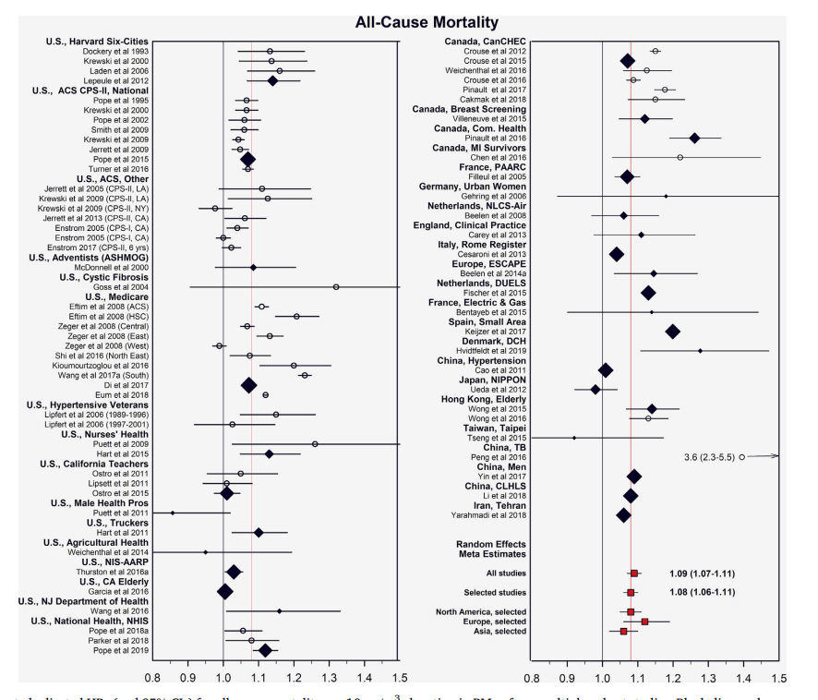
Figure 1 from Pope et al., https://doi.org/10.1016/j.envres.2019.108924, 2020.
Best guess R is 1.08 or 1.09
Recall range of 1.06 (ACS) to 1.14 (H6C)

Slide 55
Emission Factors
Emissions typically proportional to amount of “activity” that generates them:
E = (Emission Factor) x (Activity Level)
All important details are buried in emission factor
lots of work required to measure/estimate them
Significant remaining challenges
Volatility (and therefore evaporation) of primary organic particles
Size distribution of primary particles, especially in ultrafine mode
Widespread, highly variable “area” sources (e.g. ammonia, biogenic VOCs)
Some emissions are “online” vs “offline”
Offline: pre-calculated input data fed into model (e.g. vehicles)
Online: emissions rate depends on meteorological conditions (e.g. isoprene, wind-driven sea spray and mineral dust)
Emissions are nearly always a significant source of uncertainty in any CTM modeling study

Slide 56
Emissions: Broad Categories
less uncertain
 | Natural | Anthropogenic
Point | Volcano (SO₂) | Power plant smokestack (SO₂)
Line |  | VOCs from cars on highway
Area | VOCs from vegetation | NH₃ from livestock on farm
more uncertain

Slide 57
Policy Implementation Costs
Typically need to consider
initial capital costs
ongoing fuel or maintenance costs
Over lifetime of equipment
May need other costs such as enforcement, educational, etc.
Equivalent Annual Cost (EAC) is a good metric to use (see engineering economics textbooks)
Should be difference in EAC between policy and baseline scenarios

Slide 58
Topic 4: Willingness to Pay to Prevent Mortality / Value of Statistical Life
NACA RCM Workshop
Kempton Park, South Africa
October 4, 2022

Slide 59
Caution Before We Begin
Question: what should we be willing to pay to prevent risk of premature mortality from air pollution (or any other) cause?
This is not a science question with a right/wrong answer!
It is a value judgment with ethical implications
People may have legitimately different preferences, e.g. more/less risk averse
VSL = Value of a statistical life is one answer to this question
It can be controversial. You don’t have to use it. Many people do find it useful.

Slide 60
Value of a Statistical Life (VSL)
E.g. the US EPA recommends a VSL value of about $8M (USD)
Imagine a hypothetical policy expected to save 100 lives somewhere in the country (we don’t know who or where)
$8M per live x 100 lives = $800M
VSL says if the policy costs <$800M to implement, we should do it; otherwise no.
Controversy: it seems like we are saying “a human life is worth $8M” … but reality is more subtle

Slide 61
Arguments for VSL
VSL should be more than zero (!)
Cannot be infinite (limited resources)
Better to be explicit than implicit
If we avoid picking a value, we will be adopting a VSL implicitly anyway
Best to be consistent about choice of value
In a democratic society, the government spends society’s money (public or private) every time it passes a policy
It makes sense for government to make spending choices that reflects the preferences of its own citizens

Slide 62
Value of a Statistical Life (VSL)
In fact, people make decisions everyday that make tradeoffs between safety and economics
Driving a car
Using a cookstove
Getting paid more for a more dangerous job
These decisions imply somebody’s
Willingness-to-pay to avoid risk
Willingness-to-be-paid to accept risk
If a government has to make similar decisions, it makes sense to adopt values similar to its citizens

Slide 63
Value of a Statistical Life (VSL)
In the United States…
Various economic studies indicate that…
For a hypothetical risk of premature mortality of 1 in 1,000,000
Average American is willing to spend $8 to avoid it
On societal scale, this implies willing to pay $8M to avoid a premature mortality (VSL)

Slide 64
Value of a Statistical Life (VSL)
Willingness to pay to avoid (small) mortality risk
E.g. additional wages for more dangerous job
Not value or compensation for life lost
Economic work tries to infer people’s preferences from market behaviors
WTP ≠ medical, hospital, or other incurred costs
Value increases with income and inflation
EPA literature review recommends $7.4M ($2006)
26 studies cited: $0.85 - $19.8 (Weibull distribution)
Guidelines for Preparing Economic Analyses; National Center for Environmental Economics, Office of Policy, US EPA, 2010.
https://www.epa.gov/sites/production/files/2017-09/documents/ee-0568-22.pdf

Slide 65
VSL Adjustment
“It is important to emphasise that the VSL is not the value of an identified person’s life, but rather an aggregation of individual values for small changes in risk of death (OECD, 2012).”
OECD Working Paper NO. 333, The Cost of Air Pollution in Africa, Rana Roy

Slide 66
Value of a Statistical Life (VSL)
What about other countries?
Willingness-to-pay and VSL depend on ability to pay (income)
Same arguments imply that country’s VSL should be higher/lower depending on per capita income
This is not an ethical statement about the value of human life in different countries
It’s a practical statement about the resource constraints faced by different countries and how their citizens react to these circumstances
This understandably makes people uncomfortable
Others say problem is not VSL per se but a world economic situation with large inequality between countries

Slide 67
VSL and Equity
US EPA uses a relatively high VSL = $8M, consistent with being a rich country
It is probably a “necessary evil” that other countries use lower/higher values per their resources
However, within country, US EPA uses same VSL for all people, regardless of their personal income
I recommend this practice

Slide 68
Adjusting the VSL
Several reasons you might want to adjust VSL
1) different income levels across countries
2) economic growth from year-to-year increases willingness-to-pay
3) inflation: changing dollar year
Standard inflation adjustment techniques
4) uncertainty in underlying VSL

Slide 69
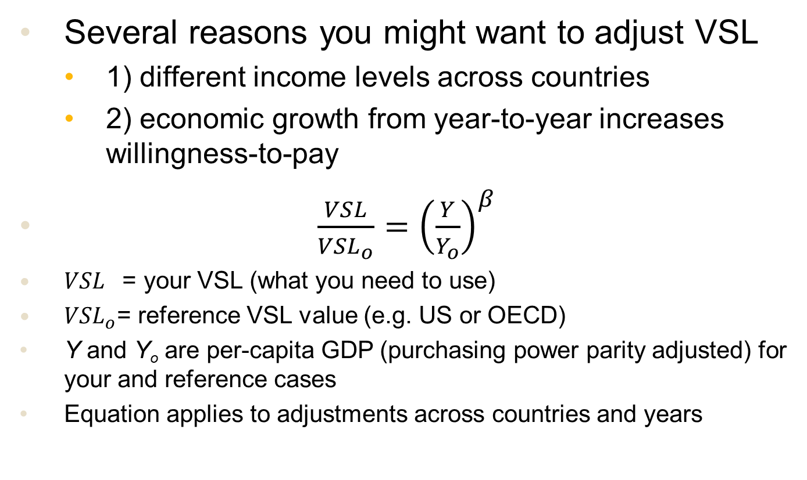
Adjusting the VSL
Several reasons you might want to adjust VSL
1) different income levels across countries
2) economic growth from year-to-year increases willingness-to-pay
$\frac{VSL}{{VSL}_{o}}={\left(\frac{Y}{Y_{o}}\right)}^{β}$
${VSL}_{}\text{= }\text{your} \text{VSL}\text{ (}\text{what} \text{you} \text{need} \text{to} \text{use}\text{)}$
${VSL}_{o}$= reference VSL value (e.g. US or OECD)
Y and Y_{o} are per-capita GDP (purchasing power parity adjusted) for your and reference cases
Equation applies to adjustments across countries and years
OECD Working Paper NO. 333, The Cost of Air Pollution in Africa, Rana Roy

Slide 70
VSL Adjustment
Across advanced economies, there is empirical evidence for a β value of 0.8
Not much evidence for lower-income countries
OECD working paper recommends 0.8, 1.0, and 1.2 as sensitivity cases
OECD Working Paper NO. 333, The Cost of Air Pollution in Africa, Rana Roy

Slide 71
Topic 5: Introduction to Policy Evaluation and Decision-Making
NACA RCM Workshop
Kempton Park, South Africa
October 4, 2022

Slide 72
Decision Frameworks
Framework | Questions it answers | Level of RCM analysis | Notes
Impact analysis | How many lives saved by policy? | Easy / marginal damages only
Cost-effectiveness | Out of several policy interventions, which seem best / high priority? | Easy / marginal damages only
Benefit-cost analysis | Is a policy intervention “worth the cost”? | Easy / marginal damages only | *requires use of a VSL
Ambient concentration standards | Will concentrations in certain areas reach the desired target? E.g. a WHO standard? | Moderate / need to do source-receptor analysis

Slide 73
Impact Analysis
Nothing fancy…
…just quantify number of lives saved for the policy intervention under consideration
…not hard to do, good to know
…limited help in evaluating “how good” policy is
…is first step towards other analyses anyway

Slide 74
Cost-Effectiveness Analysis
Idea: prioritize emissions reductions that bring most benefit for least cost
Needs:
Number of lives saved (from RCM)
Implementation cost of the policy ($)
The cost-effectiveness metric is the ratio:
Lower cost (per life saved) is better
$$Cost−effectiveness= \frac{\$ implementation cost (\$)}{lives saved}$$

Slide 75
Cost-Effectiveness Analysis
Given a number of policy interventions under consideration, can help prioritize which are best to do first
Start with easiest, lowest cost (per life saved) and work way up to more costly
Limitations
Some policy interventions may be too costly to make sense; need to go beyond cost-effectiveness (e.g. benefit-cost analysis) to decide this
Behavioral and other implementation considerations: energy efficiency can save money … but few people do it
A highly cost-effective strategy may only reduce PM2.5 a little

Slide 76
Benefit-Cost Analysis
Consider an emissions reduction strategy
Then quantify:
If benefits > costs, policy is worth pursuing
RCMs are used to quantify benefits (estimating costs done separately)
Benefits to society:
Lives saved, avoided illness, other environmental benefits
Economic costs of policy:
Money spent on control equipment, lost economic activity
< >

Slide 77
Benefit:Cost Ratio
For an emissions control is simply defined as
$\frac{Benefits of avoided mortality (\$)}{Costs of emissions controls (\$)}$
If B:C ratio > 1
Benefits exceed costs
Emissions control is “worth the cost”
If B:C ratio >> 1
Uncertainties in air quality modeling, health effects won’t matter much
This conclusion is unlikely to be affected

Slide 78
Ambient Standards
Set a maximum PM2.5 concentration that should not be exceeded
E.g. World Health Organization guidelines
Underlying philosophy = everyone has right to clean air
(contrast to economic-based approaches we’ve seen)
Requires source-receptor modeling
Could formulate question as
“What is least costly way to bring all areas into compliance with concentration standard?”
This is a complex optimization exercise

Slide 79
Other Considerations
Policy analysis tools such as benefit-cost analysis etc. are very useful quantitative analyses
However, qualitative practical considerations (public acceptance, politically feasible) can be equally or more important
Air quality and policy analysis can help build acceptance of a policy

Slide 80
Working Mini-Session
Please work on
Problem #3
Problem #4
https://drive.google.com/drive/folders/1SJhJHQRyf2aCbIu7xLTJTIYq2kjEkizu

Slide 81
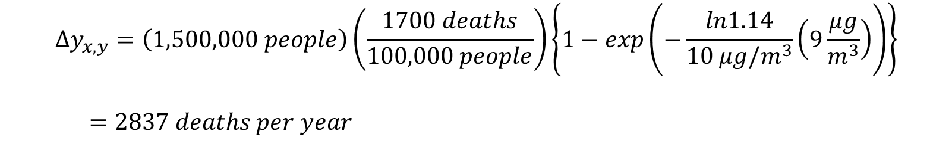
Problem #3 Solution
Concentration-response function:
Pittsburgh with H6C, R=1.14:
$$∆y_{x,y}=\left(1,500,000 people\right)\left(\frac{1700 deaths}{100,000 people}\right)\left\{1−exp\left(−\frac{ln1.14}{10 μg/m^{3}}\left(9\frac{μg}{m^{3}}\right)\right)\right\}$$
$=2837 deaths per year$

Slide 82
Problem #3 Solution
 |  |  |  |  | Relative Risk
 |  |  |  | 1.06 | 1.09 | 1.14
City | Population above 30 | Baseline mortality rate (deaths per 100,000 people) | PM2.5 concentration (μg/m3) | Annual mortalities
Pittsburgh | 1.50E+06 | 1700 | 9 | 1303 | 1903 | 2837
Los Angeles | 6.00E+06 | 960 | 18 | 5735 | 8276 | 12102
Each of these values is calculated as indicated on previous slide

Slide 83
Discussion: Problem #3
Here, we are asking for total mortality from all PM2.5
So the Δc is 0 μg/m³ → current conc.
(we are assuming here that marginal response ≈ average response)
The differences between R = 1.06 and 1.14 are 2.3x
The C-R function really is pretty linear

Slide 84
Problem #4
For each policy intervention…
Step 1: Mortalities prevented = marginal social cost x emissions reduction
Step 2: Cost-effectiveness = ($/yr implementation cost) / (mortalities/yr lives saved)
Note: improved coal cookstove has two affected pollutants (primary PM2.5 and NOx)
Do step 1 for each pollutant and combine

Slide 85
Problem #4 Solution
Option | Annualized Implementation cost ($/yr) | Species | Emissions reduced (tonnes/yr) | Marginal social impact (mortality/tonne) | Mortalities prevented (mortality/yr)
Catalytic converters | 50 | PM2.5 | 5.00E-03 | 9.00E-03 | 4.50E-05
Sulfur scrubbers | 1.00E+09 | SO2 | 7.00E+06 | 4.50E-03 | 3.15E+04
Low NOx burner | 5.00E+06 | NOx | 4000 | 2.60E-04 | 1.04E+00
Cookstove / improved coal | 35 | PM2.5 | 0.043 | 9.00E-03 | 3.87E-04
Cookstove / LPG | 55 | PM2.5 | 0.175 | 9.00E-03 | 1.58E-03
Total mortalities prevented (mortality/yr) | Cost-effectiveness ($/prevented mortality)
4.50E-05 | $1,111,111
3.15E+04 | $31,746
1.04E+00 | $4,807,692
3.93E-04 | $89,149
1.58E-03 | $34,921

Slide 86
Problem #4: Discussion
Wide range in cost-effectiveness values
About two orders of magnitude
Most cost-effective: cookstoves and sulfur scrubbers
$10,000s / mortality prevented
Prioritize these
Less cost-effective: catalytic converters and low NOx burners
$millions / mortality prevented
Two options for cookstoves
Mutually exclusive – can only do one
LPG looks a little bit better
I suspect my catalytic converter values are pessimistic

Slide 87
Topic 6: Realistic RCM Problem
NACA RCM Workshop
Kempton Park, South Africa
October 4, 2022

Slide 88
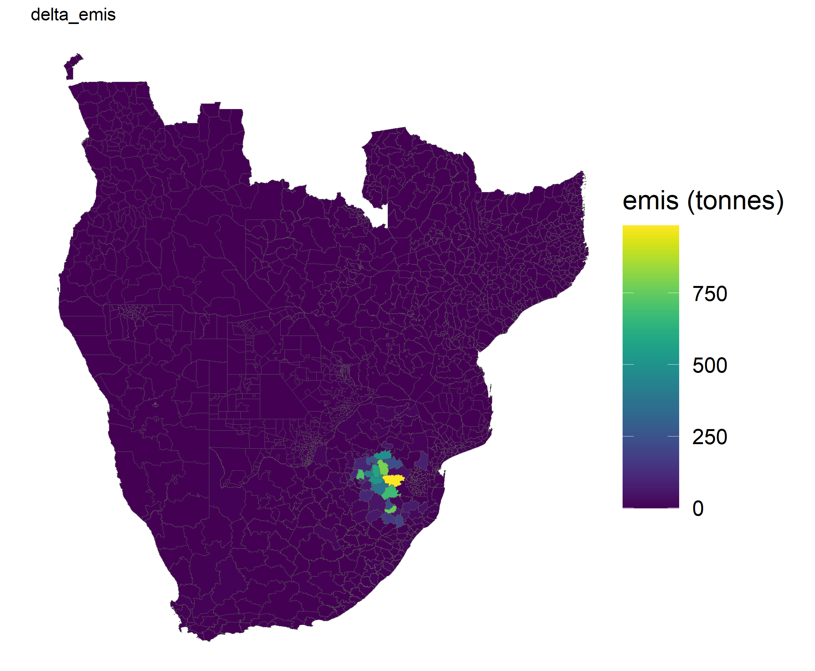
Problem Overview
Replacing residential coal stoves with cleaner-burning stoves
~90% emissions reduction
Emissions reduction given (figure)
PM2.5 Emissions reductions (tonnes/yr)
RCM is 10 countries but this scenario is S. Africa only (and focused in coal region)

Slide 89
Caveats
Emissions estimates are reasonable but maybe not “research grade”
Cost numbers are just cost of purchasing stoves
REACH-S Africa model is preliminary results
Values look good in preliminary evaluation but likely to be refined over next few months before being finalized
Recommend to wait final results before using in real assessment work

Slide 90
Files
In same Google Drive as previous problems
See subfolder: P5 Cookstove REACH problem
problem_statement.doc
README.docx
More detail on the other files
Emis_diff.csv
Given emissions reduction data
SR_PM25-PRI_ground.csv
Source-receptor matrix for ground-level, primary PM2.5 emissions
Other files (per README)

Slide 91
Sub-questions
How many lives are saved from deploying improved coal cookstoves?
Assuming a VSL for the nation of South Africa of $1.9M¹, what are the monetized benefits?
Given the estimated implementation costs of this intervention to be $2M, does this policy intervention pass a cost-benefit test? What is the benefit:cost ratio?
Make a map of the estimated ambient PM2.5 concentration reductions due to this intervention.
Plot an updated map of the PM2.5 concentrations (baseline PM2.5 – intervention PM2.5) in South Africa.
Which parts are marginal social cost and which parts are source-receptor?

Slide 92
Solution Overview
How many lives are saved from deploying improved coal cookstoves?
(Marginal social cost) x (emissions reduction) … for all municipalities summed up
= 142 premature mortalities prevented each year
Assuming a VSL for the nation of South Africa of $1.9M¹, what are the monetized benefits?
(142 mortalities per year) x ($1.9M) = $271M in benefits
Given the estimated implementation costs of this intervention to be $2M, does this policy intervention pass a cost-benefit test? What is the benefit:cost ratio?
B:C ratio = $271M / $2M = 135

Slide 93
Problem #5 Notes
B:C ratios of ~10 and ~100 are fairly common in air quality policy assessment
There are uncertainties in any such assessment but B:C of more than 100 is robust
Hard to conceive alternative assumptions that would yield costs > benefits
These are just benefits from ambient PM2.5 exposure
This does not include substantial reductions due to residential exposure

Slide 94
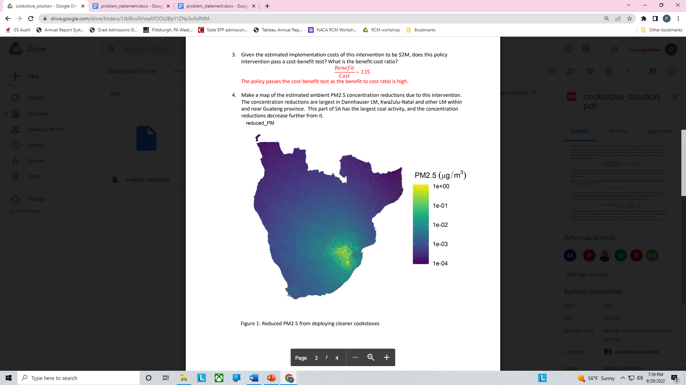
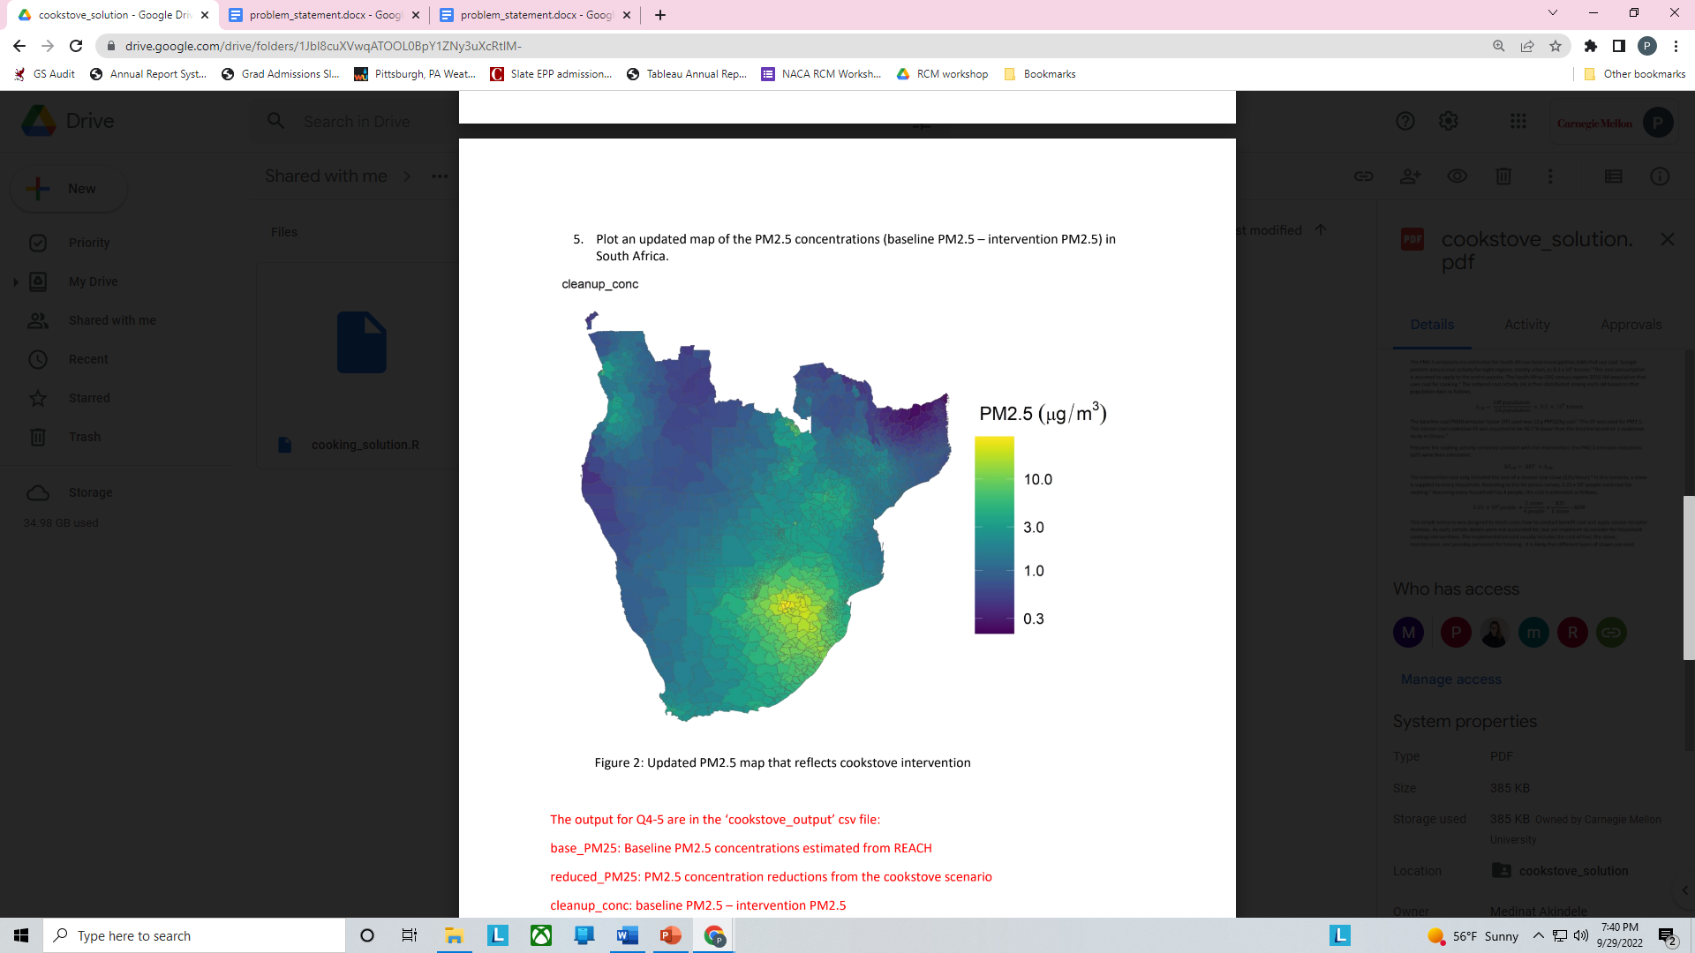
Solution Overview
PM2.5 reductions due to policy intervention
New PM2.5 concentrations after intervention

Slide 95
Topic 7: RCMs and their Evaluation
NACA RCM Workshop
Kempton Park, South Africa
October 4, 2022

Slide 96
RCMs: Pros / Cons
Tool | Method | Pros | Cons
APEEP / REACH | Gaussian dispersion + simple chemistry | Very easy to set up new domains of interest (~2-3 weeks) | Poorer performance for nonlinear chemistry (NOx, NH3) best when calibrated to speciated measurements
EASIUR | Statistical fit to tagged CTM simulations | Results mimic CTM results very closely | Requires a CTM for domain of interest lots of CTM simulations
EASIUR has higher overhead to set up but more rigorous
Nice to have multiple models (robustness check)

Slide 97
Global Efforts
We started RCMs to bring air quality analysis to a broader audience in the US.
If RCMs are useful in the US, they might be transformative in countries with little or no capacity to run CTMs.
Unfortunately, the tools I’ve described are hard-wired for US but…

Slide 98
Global Efforts: What Exists
REACH model (Rapid Estimation of Air Concentrations for Health)
Developed at CMU by Medinat Akindele and Peter Adams
Gaussian dispersion + simple chemistry (similar to APEEP)
Applicable to any region of the globe
South Africa region: preliminary results available
Global InMAP
InMAP RCM already adapted to global scale
Has not yet reported marginal damages or source-receptor
Coarser resolution
https://chemrxiv.org/engage/chemrxiv/article-details/60c756c90f50dbc115398148
Goal: EASIUR-Africa (derived from CTM)

Slide 99
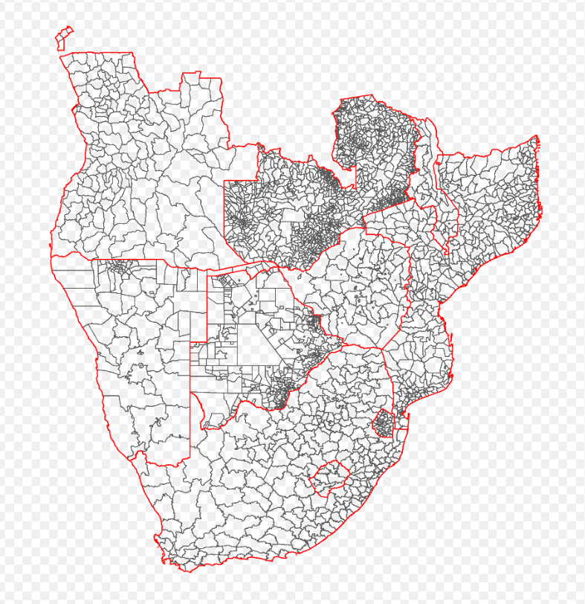
REACH: Southern Africa
New regions can be set up in ~2-3 weeks
Defaults are EDGAR emissions and ERA5 meteorology
Evaluation takes longer and depends on what observations are available

Slide 100
RCMs Africa plans
Evaluate Southern Africa REACH RCM vs observations
Develop other REACH RCM regions per interest
Build network of interested researchers
CMU-Africa follow-on grant
Academic network of RCM developers / evaluators
Network of RCM users: academic but also policy-makers
Build EASIUR-Africa RCMs

Slide 101
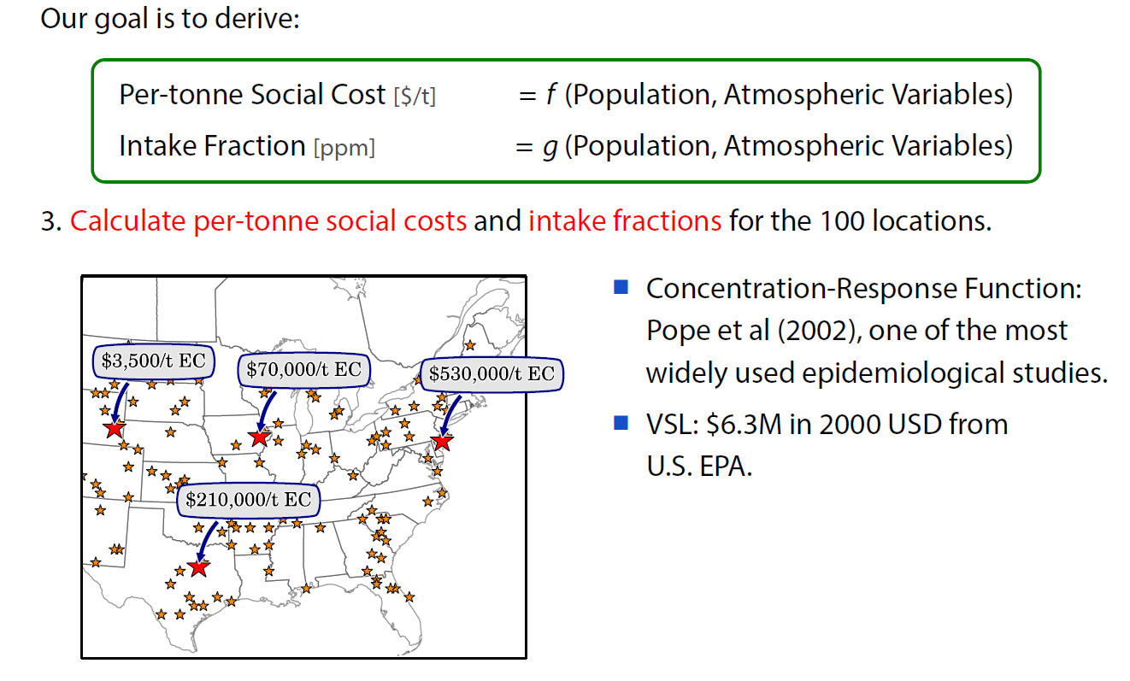
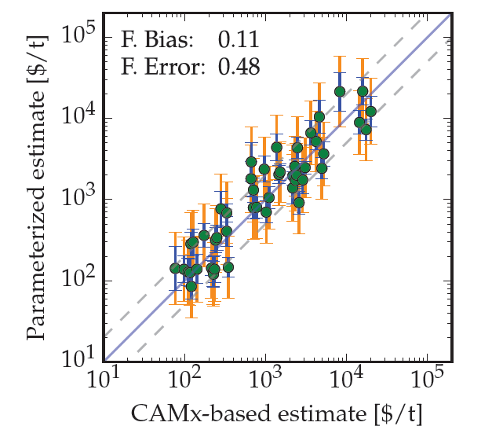
EASIUR: statistical model of CTM
NOx (summer) out-of-sample

Slide 102
EASIUR Evaluation
For EASIUR-US, the typical error in marginal social cost (compared to full CTM) is typically 20-30%

Slide 103
County Marginal Social Costs ($/ton)
Primary PM_{2.5}
SO₂
NO_{x}
NH₃

Slide 104
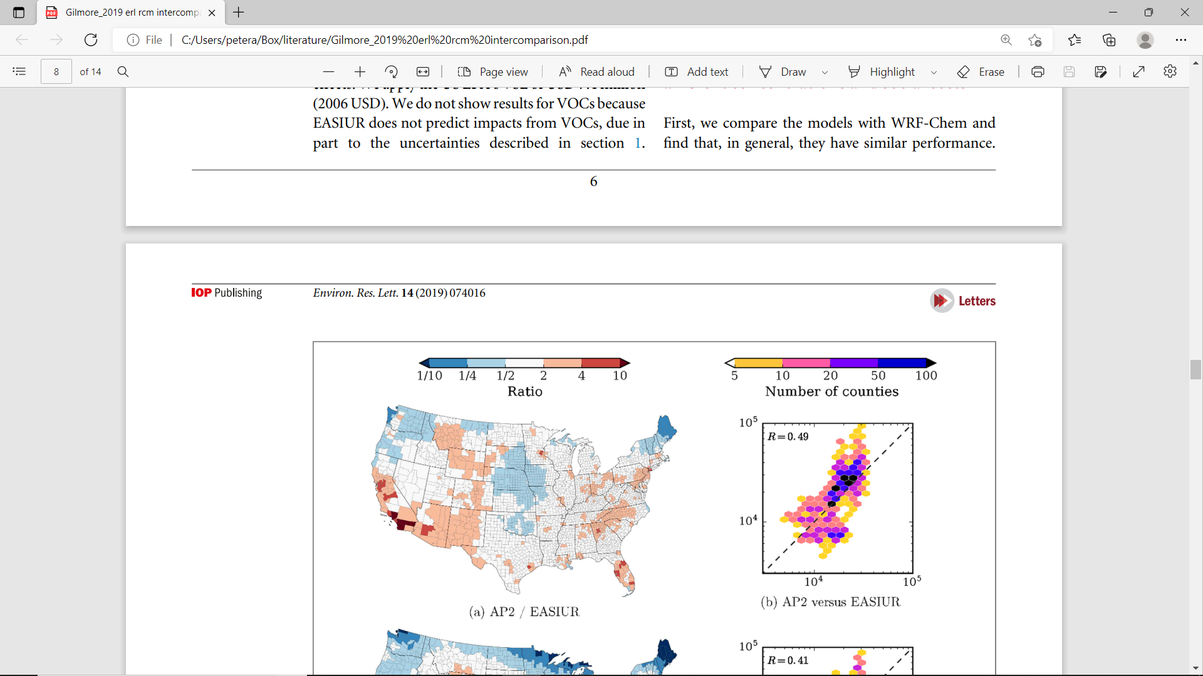
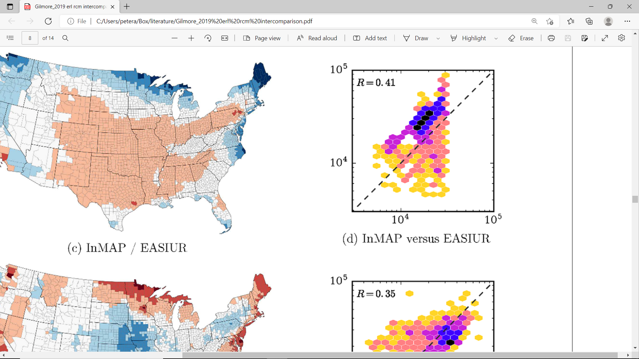
RCM Intercomparison (United States)
Marginal social costs ($/tonne) for SO2 emissions
(Approx. 3000 counties in the US)
For damages from one single location (SO2):
Most counties are within factor of 2 agreement
In rare cases, damages might vary by as much as 10x
For damages from a mix of sources across US:
Models agree to within 10-40%
…depending on species emitted
InMAP RCM
EASIUR RCM

Slide 105
Topic 8: Best Practices
NACA RCM Workshop
Kempton Park, South Africa
October 4, 2022

Slide 106
Overview of Best Practices
Uncertainty assessment
“Regret”: uncertainty in decision context
When does linear assumption break down?
When does emissions baseline matter?

Slide 107
Uncertainty Analysis
Air Quality
For US, we have 3 RCMs and recommend that people use all three as robustness check
recall that structure and derivation of three RCMs are strongly independent
For Southern Africa, we have only REACH right now (but plan to create an EASIUR RCM too)
Gilmore et al. (https://doi.org/10.1088/1748-9326/ab1ab5) is a good guide to uncertainty in RCMs
Note that air quality uncertainty will often be << uncertainty from C-R and VSL

Slide 108
Uncertainty by component
Sulfate
Inorganic chemistry pretty well understood / trust the RCM evaluations for uncertainty guidance here
Nitrate
Ammonia: agricultural emissions are poorly quantified
Ammonium
Organic carbon
Organic chemistry of SOA is poorly understood / needs to be considered on top of RCM uncertainty / we are working on guidance for this
Primary PM (including POA): atmospheric behavior is pretty simple / trust RCM evaluations for uncertainty here / major uncertainty will be emissions
Elemental carbon
Other: trace metals, crustal, etc.

Slide 109
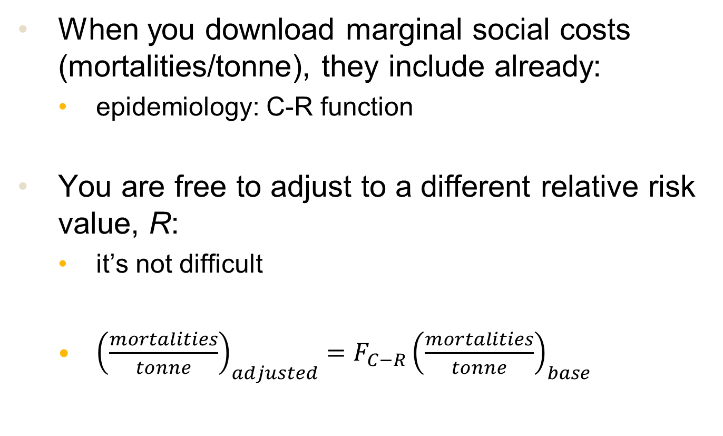
Changing Assumptions
When you download marginal social costs (mortalities/tonne), they include already:
epidemiology: C-R function
You are free to adjust to a different relative risk value, R:
it’s not difficult
${\left(\frac{mortalities}{tonne}\right)}_{adjusted}={F_{C−R}\left(\frac{mortalities}{tonne}\right)}_{base}$

Slide 110
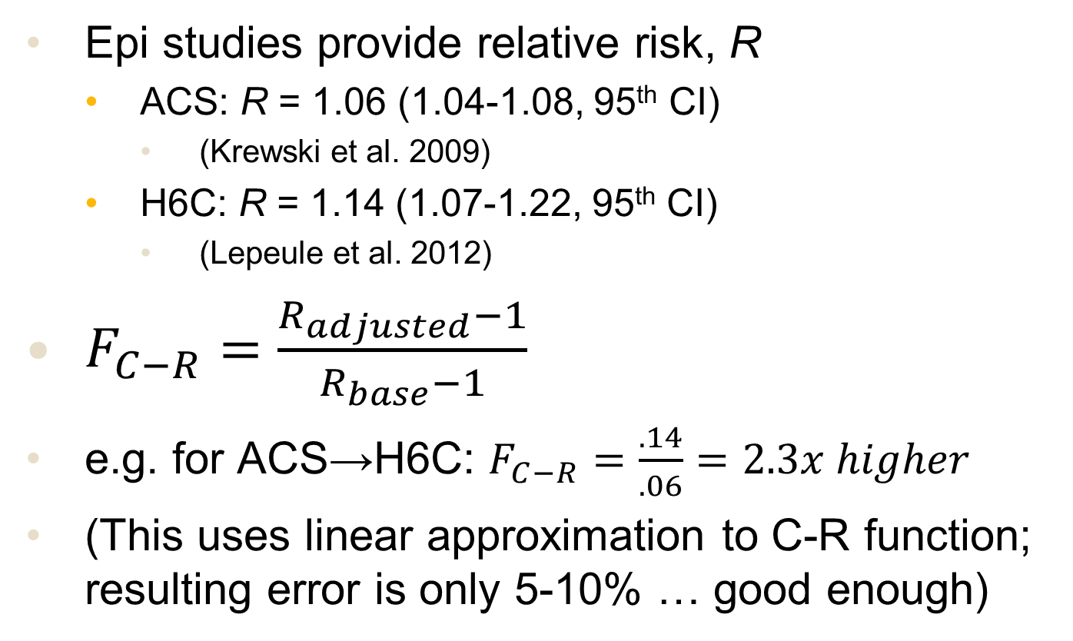
Changing the C-R Function
Epi studies provide relative risk, R
ACS: R = 1.06 (1.04-1.08, 95th CI)
(Krewski et al. 2009)
H6C: R = 1.14 (1.07-1.22, 95th CI)
(Lepeule et al. 2012)
$F_{C−R}=\frac{R_{adjusted}−1}{R_{base}−1}$
e.g. for ACS→H6C: $F_{C−R}=\frac{.14}{.06}=2.3x higher$
(This uses linear approximation to C-R function; resulting error is only 5-10% … good enough)

Slide 111
Changing the VSL
You will usually be starting with some recommended VSL value from literature
Several reasons you might want to change
1) assess uncertainty in underlying VSL
2) economic growth increases willingness-to-pay
3) apply to different country; adjust for per capita income
4) inflation: changing dollar year
Reminder: these were addressed earlier in section on VSL

Slide 112
Sensitivity and Uncertainty Analysis
Public policy analysis tends to deal with much higher level of uncertainties than physics lab
We just reviewed how to quantify uncertainty related to benefits of a policy
Now we need to discuss what uncertainty is “too much” and whether a proposed decision is “ok” in a robust sense.

Slide 113
What is a Robust Decision?
Robust =
If we pursue this decision (or policy),
Despite considerable uncertainties (even 2-10x)
We are sure (or highly confident) that the public is better off as a result
i.e. we don’t need precise values for costs or benefits … just confidence that benefits > costs

Slide 114
What’s an “acceptable” level of uncertainty??
It depends on the problem…
We want to do technical and policy analysis to inform a decision
Should I choose option A, B, or C?
Is this proposed policy better than the status quo?
The decision context makes all the difference here
When you know enough to be fairly confident about a recommendation, your uncertainty is “acceptable”
Start with the decision … then do the analysis

Slide 115
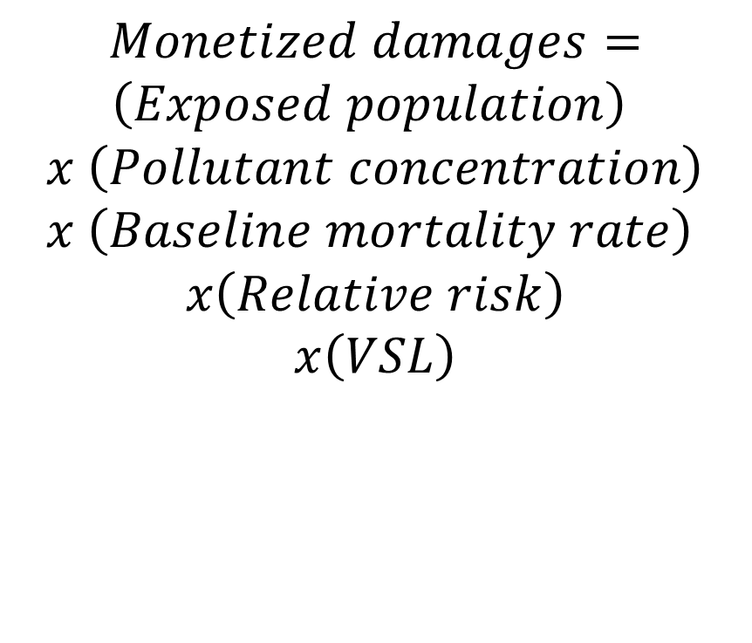
Example: Benefits of Prevented Air Pollution
$$Monetized damages=$$
$$\left(Exposed population\right)$$
$$x \left(Pollutant concentration\right)$$
$$x \left(Baseline mortality rate\right)$$
$$x\left(Relative risk\right)$$
$$x\left(VSL\right)$$
What are the biggest uncertainties?
How big?
Baseline mortality rate (# deaths per year per 100,000 people)
Relative risk (% increase in mortality per unit pollution)
VSL (Value of statistical life, willingness to pay in $ to reduce mortality risks)

Slide 116
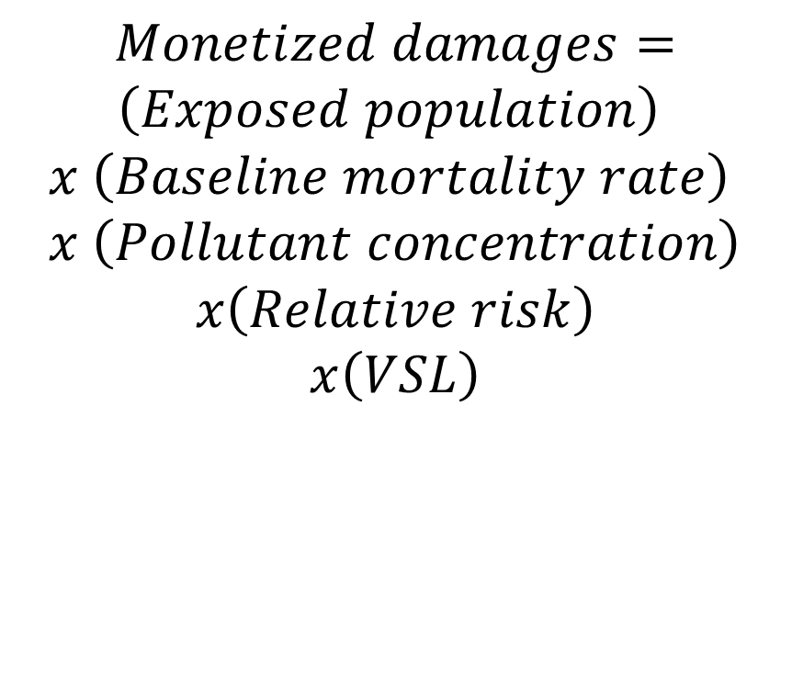
Example: Benefits of Prevented Air Pollution
$$Monetized damages=$$
$$\left(Exposed population\right)$$
$$x \left(Baseline mortality rate\right)$$
$$x \left(Pollutant concentration\right)$$
$$x\left(Relative risk\right)$$
$$x\left(VSL\right)$$
What are the biggest uncertainties?
~a factor of two*
~order of magnitude
Baseline mortality rate (# deaths per year per 100,000 people)
Relative risk (% increase in mortality per unit pollution)
VSL (Value of statistical life, willingness to pay in $ to reduce mortality risks)
*for fine particulate matter

Slide 117
Example: Benefits of Prevented Air Pollution
Estimated benefits from any air pollution reduction have uncertainty of probably an order of magnitude
However, the benefits are often 100x as large as the costs
Despite uncertainties that seem large, we can (sometimes) be quite confident about decisions…

Slide 118
What about when the uncertainty does affect my decision?
“Value” of a decision (e.g. Benefits minus costs)
Option A
Option B (might be doing nothing)
Some uncertain parameter (e.g. VSL)
“Crossover” analysis
Option B is preferred
Option A is preferred

Slide 119
What about when the uncertainty does affect my decision?
Range of values (e.g. VSL)
“Value” of a decision (e.g. Benefits minus costs)
If the range of VSL values is as shown, Option A is always better than Option B, so we should select it with confidence
Option A
Option B (might be doing nothing)
Some uncertain parameter (e.g. VSL)
“Crossover” analysis
Option B is preferred
Option A is preferred

Slide 120
What about when the uncertainty does affect my decision?
“Value” of an option (utility, NPV, etc.)
Option A
Option B
If the bounds on x span the “crossover” point, I’m not sure which option is better
Some uncertain parameter, x
x_{min}
x_{max}

Slide 121
It turns out you can quantify “regret”
If x = x_{true} but I chose Option B, I’m not as well off as I could have been
Regret = difference in value outcome between best choice and what you chose
“Value” of an option (utility, NPV, etc.)
Option A
= regret
Option B
Some uncertain parameter
x_{true}

Slide 122
What about when the uncertainty does affect my decision?
“Value” of an option (utility, NPV, etc.)
Option A
Uncertainty matters to the decision when x spans crossover point
Fortunately, this is also when regret is smallest
i.e. near crossover point, Option A and B are almost equally good
…unless the uncertainty in x is really big …
Option B
Some uncertain parameter, x
x_{min}
x_{max}

Slide 123
What’s an “acceptable” level of uncertainty??
This is not really the right question…
Often, there is little you can do to reduce uncertainty
However, you can always quantify uncertainty
… and ask whether the uncertainties might change your decision or recommendation

Slide 124
Overview of Best Practices
Uncertainty assessment
“Regret”: uncertainty in decision context
When does linear assumption break down?
When does emissions baseline matter?

Slide 125
Applying Marginal Damages to Different Years and “Baseline” Scenarios?
Goal: Look at marginal damages around two different baselines – how different are they?
Perturbed precursor emissions of inorganic PM_{2.5} around a present (2008) and future (2050+) base case.
Focus of study is on how atmospheric chemistry may change in the future. No changes to VSL or demographics considered.

Slide 126
Methods
Ran CTM (PMCAMx) with 36 km resolution
Monthly simulations for January and July
Present-case emissions derived from 2008 NEI
Future-case emissions scaled to match RCP4.5 2057 projections
VSL = 7.4 million 2006 USD
RR = 1.06 (Krewski et al 2009)
Population based on tract-level 2010 census data

Slide 127
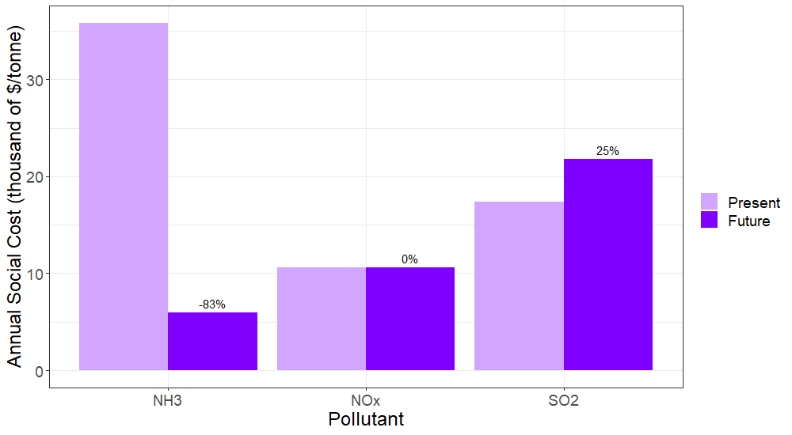
Small changes in marginal damages (except NH₃)

Slide 128
Nonlinearities by component
Sulfate
Sulfate is part of nonlinear inorganic system / but results tend to be well behaved … little concern here
Ammonium nitrate system is highly nonlinear; be very cautious about large changes in these emissions of application to scenarios far in future
Nitrate
Ammonium
Organic carbon
SOA: semi-volatile so absorptive partitioning depends on how much organic PM there is; weakly nonlinear
Primary PM (including POA): linear, limited/no interactions with other species
(not entirely true for POA but tends not to matter much)
Elemental carbon
Other: trace metals, crustal, etc.

Slide 129
Nonlinear Interactions: Summary
Nonlinearities tend to be less of a problem than many air quality experts first assume
Linear + weak interactions =
RCMs will work best here / can “think marginally” / can do a piece of PM system in isolation, i.e. without a complete or perfect emissions inventory
Nonlinear interactions =
Ok for smaller changes / larger changes mean larger uncertainties from RCM / may want to use CTM

Slide 130
Concluding Thoughts
RCMs provide a means to do science-based policy assessment – in a very accessible way
There are significant uncertainties in any policy assessment exercise
RCMs and air quality typically less uncertain than C-R and VSL
…but very high benefits of many air quality policies means decisions are often robust/justified
Larger challenges are determining costs and emissions reductions of a policy
…but RCMs help because you can often focus just on affected emissions (not complete inventory)

Slide 131
We Want Your Feedback
Participant list:
https://docs.google.com/spreadsheets/d/11gYHmO-AfklROrF4ROdRJ8AsHj1uLjzqLXVl7GIvGHk/edit#gid=0
Short survey about today’s workshop:
https://forms.gle/SpSJxqu38vN4hwz1A
Future questions can go to:
peteradams@cmu.edu
All slides, questions, solutions will be posted online

Slide 132
Backup Slides

Slide 133
RCM Intercomparison
Social costs ($/ton) of primary PM_{2.5} emissions as a function of source county
InMAP ($/ton)
EASIUR ($/ton)
Ratio: InMAP / EASIUR

Slide 134
RCM Intercomparison
Social costs ($/ton) of primary PM_{2.5} emissions as a function of source county
AP2 ($/ton)
InMAP ($/ton)
Ratio: AP2/InMAP

Slide 135
RCM Evaluation vs Observations
Use RCMs to predict PM_{2.5} and speciation from EPA AirData
Note our impacts are marginal - do not necessarily expect to reconstruct concentrations in nonlinear system
Model performance similar to a CTM (WRF-Chem)
Models
Species

Slide 136
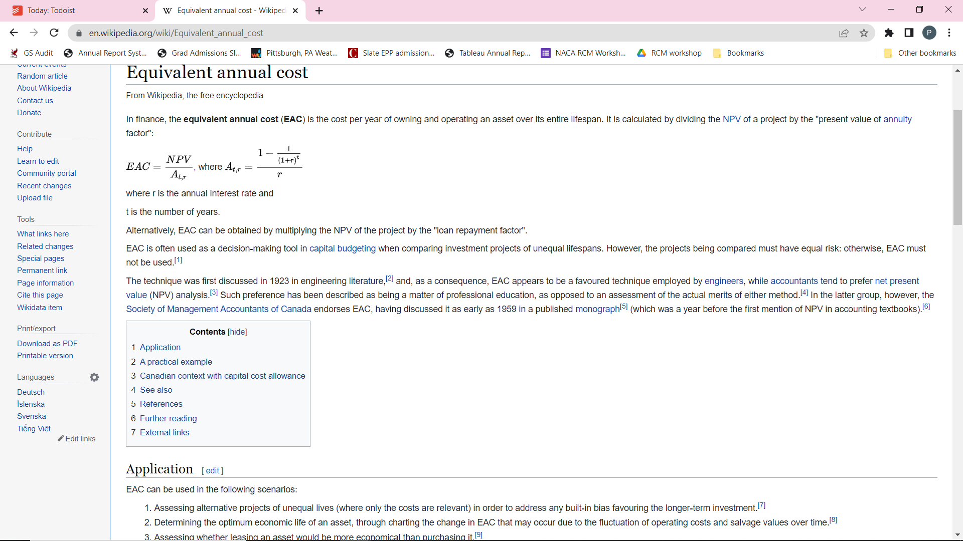

Slide 137
